Slide 1
Labyrinthine Rush
A 2D Puzzle & Shooting
Game

Slide 2
Language & External Libraries:
C++
SDL 2.0.8 (Graphics library)
SDL_Image 2.0.3 (Image processing library)
SDL_Mixer 2.0.2 (Sound processing library)
SDL_TTF 2.0.14 (Font processing library)

Slide 3
Game Features:
Full Graphical User Interface
Instructions on Side Screen
Loading Screen & Pausing Capability
Multiple Level
Score on various parameter
High score storing
2 Types Navigation Portals
2 Types Shooting capability
Intelligent Enemy
Finding Key
Treasure Hunt
Sounds on Events

Slide 4
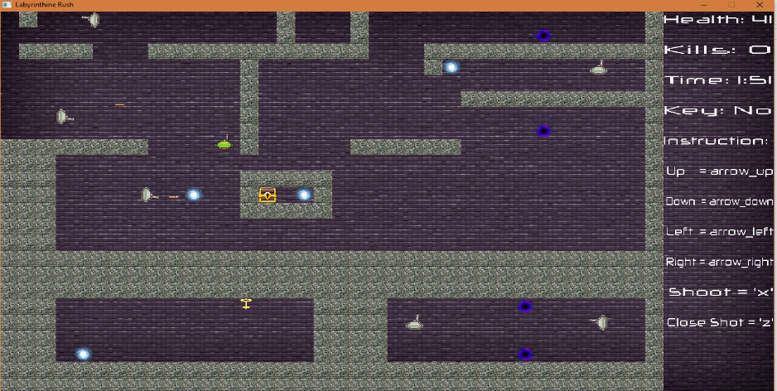
Description:
The game contains multiple levels. Each level contains its own unique maze, filled with various enemies, portals, a key and a chest. The player has to navigate through the maze, survive enemy attacks, kill enemies, find the key and finally open the chest to complete the level. Both the player and enemy have a high damage close ranged shot, and a normal long ranged shot.
Now let’s move on to
The features… … …

Slide 5
Full Graphical User Interface
The game control is from keyboard & mouse which provides the user full graphical interface.
For navigating through maze the 4 arrow key is used.
Shooting is done with key ‘x’ & Special shoot is done by ‘z’
All buttons are to be clicked by mouse pointer.
Pause menu = ‘esc’

Slide 6
Instruction on side screen:
All gaming instruction are provided in the game screen.
In the right corner of the screen, instruction are described so that the player can have a quick look.
On the top right corner of the screen health, score, kill, time and key states are displayed.

Slide 7
Loading Screen & Pausing capability:
Levels are read from files, this requires time.
While the level loads there is a loading screen.
The rate of spinning of the loading icon indicates how fast the level is being loaded.
Game can be paused during the play time just by pressing “esc” key.
Clicking the “continue” button will resume the game.

Slide 8
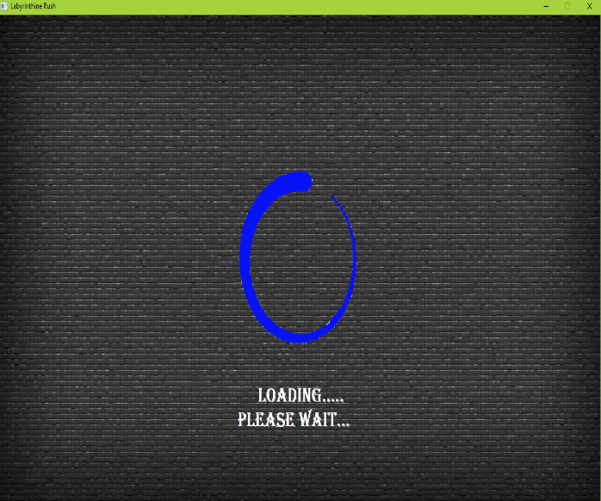
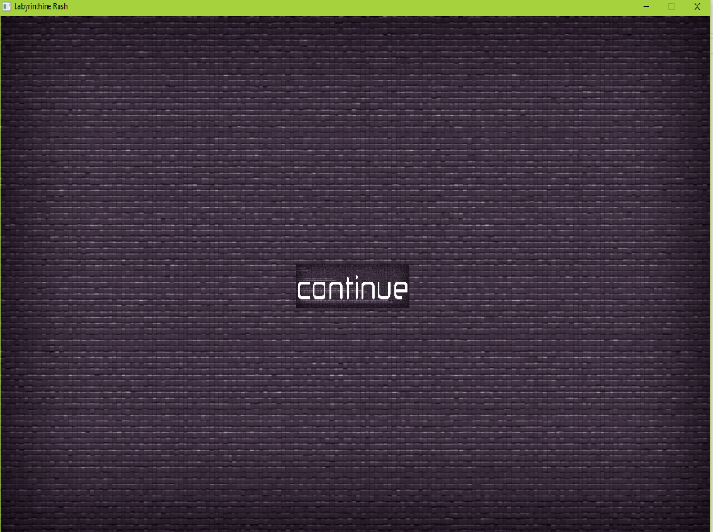
Loading & Pause Screen:

Slide 9
Multiple Level:
7 levels.
Sorted based on difficulty.
Completing one level unlocks the next one.
Player can create a new level using notepad or a similar text editor.

Slide 10
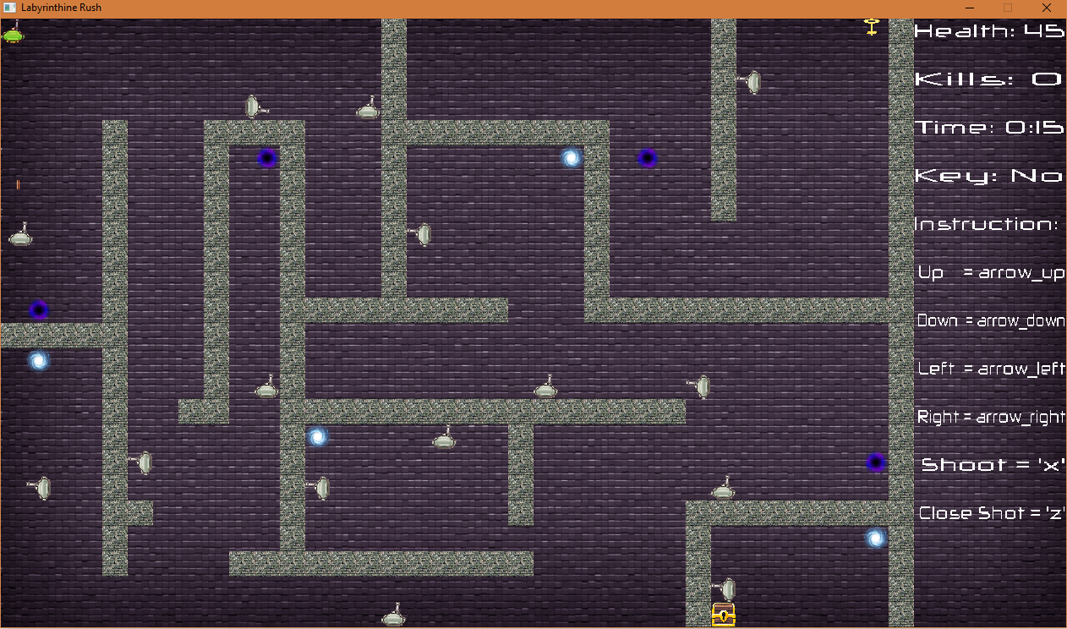
Sample Level:

Slide 11
Scoring Parameters & High scores:
Most of the score is based on kills.
Aside from that remaining player health and how fast the level was completed will also contribute towards the score.
The high score of each level is stored.
The current score and high score is displayed after completing a level.

Slide 12
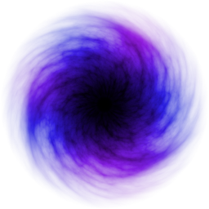

Navigating Portals:
There are 2 types of portals to navigate from one block to another.
One is permanent and the other one is temporary.
Temporary portals are destroyed after 3 second of use. So this makes the maze more complicated since, which portals takes the player where, user can’t know before hand. One mistake can lead the user to be caged in a locked block of maze.
Temporary: Permanent:

Slide 13


Shooting Capability:
Enemy and player can shoot two different types of bullet.
One is long range laser bullet other one is short range power gun.
Laser bullet decrease health by 1 unit, on the other hand power gun decreases health by 3 unit.
There is a extra feature that, one enemy’s bullet can’t harm other enemies.
Laser Bullet: Power Bullet:

Slide 14
Intelligence of Enemy:
Enemies behave intelligently depending in the position of the player.
When player comes in certain range to the enemy, enemy starts shooting.
When player is too close, the enemy shoots the power bullet.
The enemy shoots up/down/left/right depending on which direction the player is located.

Slide 15


Key and Treasure Box:
There will be a key and a treasure box located at two different spots of the maze
The player has to first find the key and the treasure box can be opened to complete the level
Key: Treasure Box:

Slide 16
Sound Effects:
For realistic feeling, different sound effects are added.
A background Music, which keeps playing all the time.
Two types of bullet have two types sound.
A perfect hit gives a collision sound.
Finally the game over or wining sounds finishes the game.

Slide 17
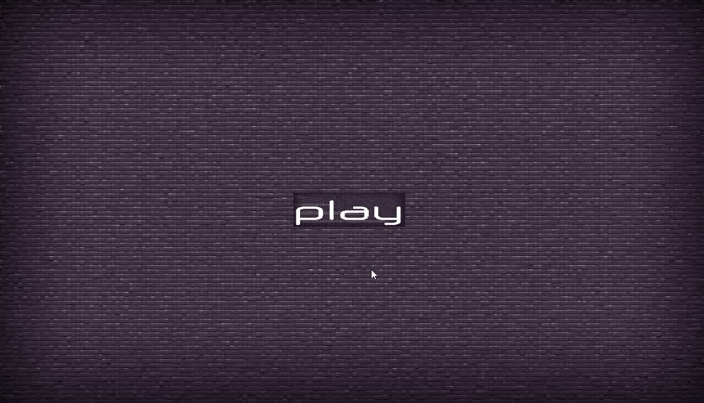
Game Play:

Slide 18
Credits:
Team Name: Team_Untitled
Team Member’s Info:
Rizvi Hasan
170041038
Core game functions implementer.
Kawsar Ahmed
170041021
Level Designer & Implementer
Asaduzzaman Herok
170041034
Sound & Visual effects

